Slide 1

Using Blockchain for improving communication efficiency and cooperation: the case of port logistics
Hangdong Chen
Supervisor: Dr. Lawrence Henesey

Slide 2
Contents
· Background
· Problem definition
· Aim
· Research questions
· Method
· Result
· Conclusion
· Future work
Notes:
Describe work – 5 steps
Briefly introduce

Slide 3
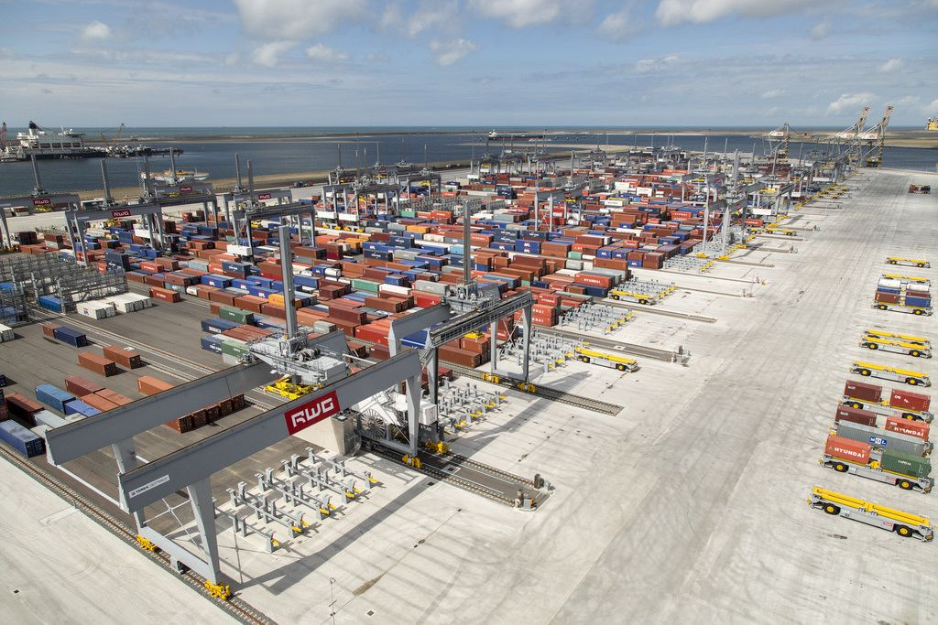
Background
Port logistics is playing an increasingly important role in global logistics.
Over 85% of the cargo has traveled at least once on board.
the cost of ship transportation is very low
Large shipping volume
etc.
Intelligent ports
AI
Blockchain
Cloud computing
IoT
AGV
Swarm management
etc.
Intelligent port case: Rotterdam port
Notes:
With the rapid development of the logistics industry, port logistics is playing an increasingly important role in global logistics.
Over 85% of the cargo has traveled at least once on board. And the advantages of shipping makes it always occupy an important position in logistics.
With the development of technology, many place have begun to develop automated ports.

Slide 4
Background
But…
Expensive intelligent equipment and infrastructure reforms
Insufficient resources in small ports
Small ports need to work with third-party companies, e.g. transportation companies
Challenge
information cannot be shared
different companies use different systems with different information
Inefficient communication
Notes:
But,
Automated ports require significant costs to purchase intelligent equipment and infrastructure reforms, so for economically developed areas and large ports such as Rotterdam and Shanghai, they have enough resources to develop it.
But for small ports, they often need to cooperate with multiple third-party companies, such as transportation companies, which means there are more challenges when cooperate and communication.
Between these companies, information did not shared, different companies use different systems with different information, all these problems reduce the efficiency of small ports and limit their development.

Slide 5






Background
We found：
Here is container information
I need some truck to deliver
Accept / Refuse
or
ship
Port manager
Port manager
Truck company
In the cooperation process, relevant information basically appears in the form of files (e.g. bill of landing, manifest, dangerous goods notice, unloading note, etc. )
Communication and information transfer between the two parties usually through bilateral communication (e.g. phone, email, etc.)
Notes:
We have found that even though port communication system has been developed for more than 30 years, when small ports cooperate with third-party companies, they still use inefficient way to exchange information.
For example, They use files to send information, and communication with phone and email.
This type is not only inefficient, but it takes a long time to review if anything lost or incorrect.

Slide 6
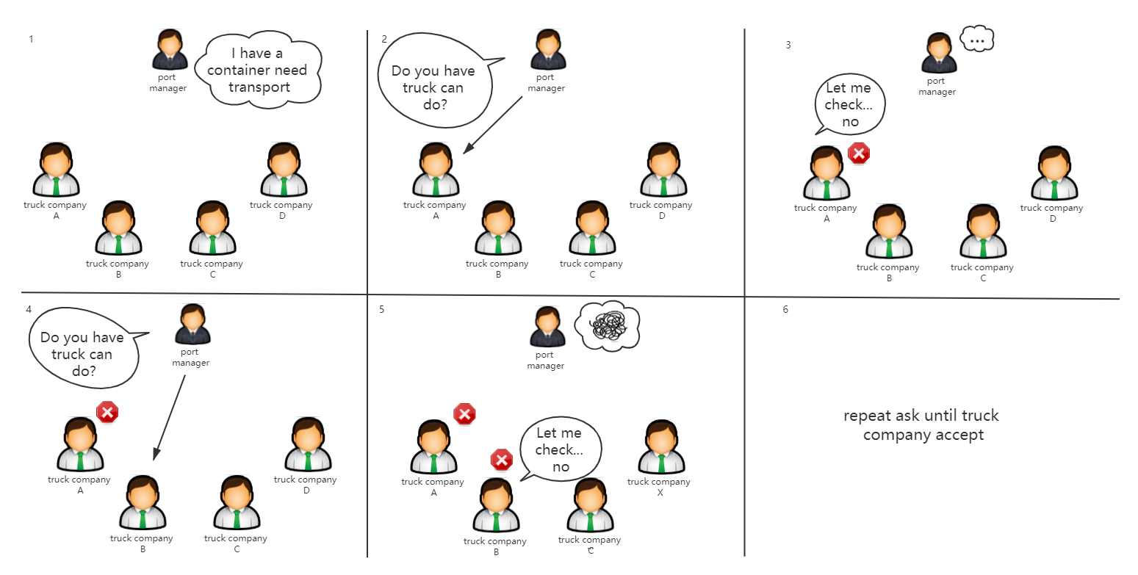

Background
I cannot ask another company to prevent double-spending, I have to wait for reply
Here is a case：
Notes:
When cooperating, there may be a problem of repeated waiting. Such a similar situation occurs in the communication between the various roles of the logistics chain.
Therefore, we hope to improve the efficiency of multi-company cooperation.

Slide 7

Background
Why?
Trust issue
Information traceability is difficult
Communication delay
Information cannot be securely shared
Low communication efficiency and high error rate
Blockchain?
Notes:
When considering some reasons that may cause this situation, we are thinking using blockchain to improve it.

Slide 8
Background
Blockchain
- Transparency | Blockchain may prevent the creation of organizational silos within existing parties of the supply chain, enabling the different actors involved in the process to access the information. This feature leads to univocal, shared and real-time accessible pieces of information. Instead of having data buried in legacy silos, ERP or TMS, data are accessible in a distributed and decentralized way to supply chain members;
- Traceability | Blockchain is able to keep track of the different processes so that every supply chain member is able to produce or collect information about the product’s lifecycle (supplier information, the manufacturing process information, logistics information and others). This not only provides a guarantee over the product’s origins, but it also offers information about the requirement for the product’s handling, transportation and storage. Finally, this feature enables an easier traceability of the causes and responsibilities for problems occurred in the process;
- Security | The information is stored in a ledger, which is a distributed data structure where transactions are organized in blocks (Kiayias et al., 2016). Each block is secure by encryption based on a hash mechanism so that the ledger becomes a proof-of-work puzzle. The access to information is based on a key system. Therefore, every member of the blockchain, the so-called “node”, is provided with a private key and a public key, which enable him to access the private information and the Blockchain respectively;
- Built-in-trust | The feature of encryption on which Blockchain is based represents the guarantee of trust towards the system. This enables the members of the blockchain to bypass the third parties that serves as a guarantee of financial, physical and information transaction in today’s supply chain. In logistics, this leads to the elimination of documents such as Bill-of-Landings, Letter-of-credits and middlemen such as Freight forwarder and banks.
- Real-time accessibility | Blockchain provides to every user with authorization a real-time access to the information. This faster and broader access to information leads to speed-up the logistic processes and avoid bottle-necks. Benefits are not only related to the information flow, but also to the financial flow.
Notes:
Because of the blockchain has the characteristics of Transparency, Traceability, Security, Built-in-trust and Real-time accessibility, it may be able to improve the communication efficiency of small ports cooperation

Slide 9
Problem Definition
The main problem we are focusing is the communication efficiency issues faced by small ports when cooperating with multiple companies.
When small port resources are insufficient, port managers ask the cooperating transport companies whether they can provide vehicles to assist in delivery. In this process, the response time of the transportation company, the time spent repeating the process many times, etc., have extended the waiting time of the container, which is very inefficient for logistics.
Notes:
Therefore, we mainly focused on the problem of low communication efficiency in the cooperation process between small ports and multiple companies and explored whether we can use blockchain to improve it.

Slide 10
Aim
The aim of this study is to explore whether blockchain technology can influence the communication efficiency of small port communication systems and identify the influencing factors.
Objectives:
-Design model system
-Using simulation methods^{[4]} to test whether blockchain technology can
improve system communication efficiency
-Summarize the feasibility of using blockchain technology in small ports
Notes:
In this research, we mainly use the simulation method to simulate traditional systems and blockchain-based system, and compare the performance differences of the models.

Slide 11
Research Questions
RQ1: Which functions and roles are affected by Blockchain based Port Community System(PCS) and how such a setting can be simulated?
RQ2: What factors in enhance or impede using Blockchain in small ports?
Notes:
So, we proposed two research questions, First determine how to simulate and then perform a system analysis

Slide 12
Methods
Literature review
1.1 Which roles are affected by Blockchain based Port Community System(PCS) ?
1.2 Which functions are affected by Blockchain based Port Community System(PCS) ?
1.3 How to compare system differences?
Simulation
Notes:
For research question 1, we need to determine roles and functions, to understand how to simulate. In order to compare system differences, we also need to determine comparison indicators

Slide 13






Methods
Literature review
1.1 Which roles are affected by Blockchain based Port Community System(PCS) ?
shipping companies
ports
inland transportation companies
customers
Suppliers
government
Because the complete PCS is too complicated, we mainly choose to simulate the communication and physical processes between the port and the inland transportation company
*[5, 6]
Notes:
According to Dr. Henesey's research and the Global Logistics Institute's analysis of PCS roles, we roughly divide the roles into 6 categories. In this research, it is unrealistic to simulate a complete port communicate system. There are very complex information interactions between different categories and within the categories, so we mainly simulate the communication and physical processes between port and inland transportation companies

Slide 14
Methods
Literature review
1.2 Which functions are affected by Blockchain based Port Community System(PCS) ?
 | Information exchange | Physical process
Port | 1. Send container information to the shipping company. 2. Receive acceptance/ rejection information from the shipping company. | 1. After receiving the container, the port needs to contact the inland transportation company for transshipment and transfer the container to the waiting area. 2. The port needs to arrange transportation vehicles to pick up containers at the storage area
inland transportation companies | 1. Receive request information 2. Determine whether the task can be completed, if it can, send the vehicle to the port, and if it cannot be completed, send a rejection message to the port | 1. Arrange vehicle transportat-ion and arrive at the designated time 2. The transport vehicle picks up the goods from the storage area and leaves the port to the customer's location.
*[5, 7]
Notes:
In Dr. Henesey's research, he list the information interactions between stakeholders and the port system. Because of the timing factor of information exchange is the physical process, it is necessary to consider the physical process together in the simulation. Combining Digital Container Shipping Association industry blue print, we screened out physical processes and information exchange between ports and inland transportation companies, which are necessary functions in the simulation system.

Slide 15
Methods
Literature review
1.3 How to compare system differences?
KPI | Description | Measurement methods
Overall time of cargo in port | The total time of the goods at the port. | The sum of waiting time, customization and commercial licenses, and process delays. Calculate the total time it takes for the goods to be unloaded from the ship to leave the port
Hinterland transportation modes’ capacity utilization | It measures the percentage of hinterland transportation’s available capacity that is being used. It defines the efficiency in transport’s utilization | Hatch transport vehicle usage rate within a certain period of time
Access speed to information | The speed in receiving or accessing the information needed at the right time in the process. Not only it is a measure of the information timing but also in- formation availability. | Calculate the time from the start of requesting information to the receipt of information
Port throughput | The port’s ability to handle containers within a certain period of time | Calculate the number of containers handled by the port within a certain period of time
Notes:
To compare the system differences, we chose four performance indicators. Overall time of cargo in port, vehicle utilization rate, access speed to information and port throughput.

Slide 16
Methods
Simulation
1. Traditional system
1.1 Bilateral communication
2. Blockchain-based system
2.1 Block
2.2 Reward mechanism
2.3 Consensus mechanism
2.4 Anti-tampering mechanism
Notes:
In simulation method, we will design two systems

Slide 17
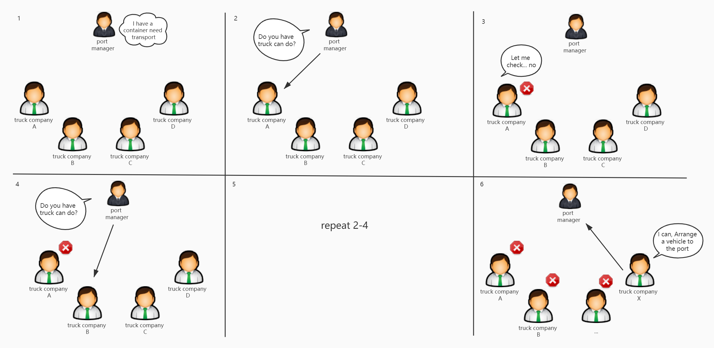
Methods
Simulation
1. Traditional system
1.1 Bilateral communication
Notes:
Traditional system will use bilateral communication,

Slide 18
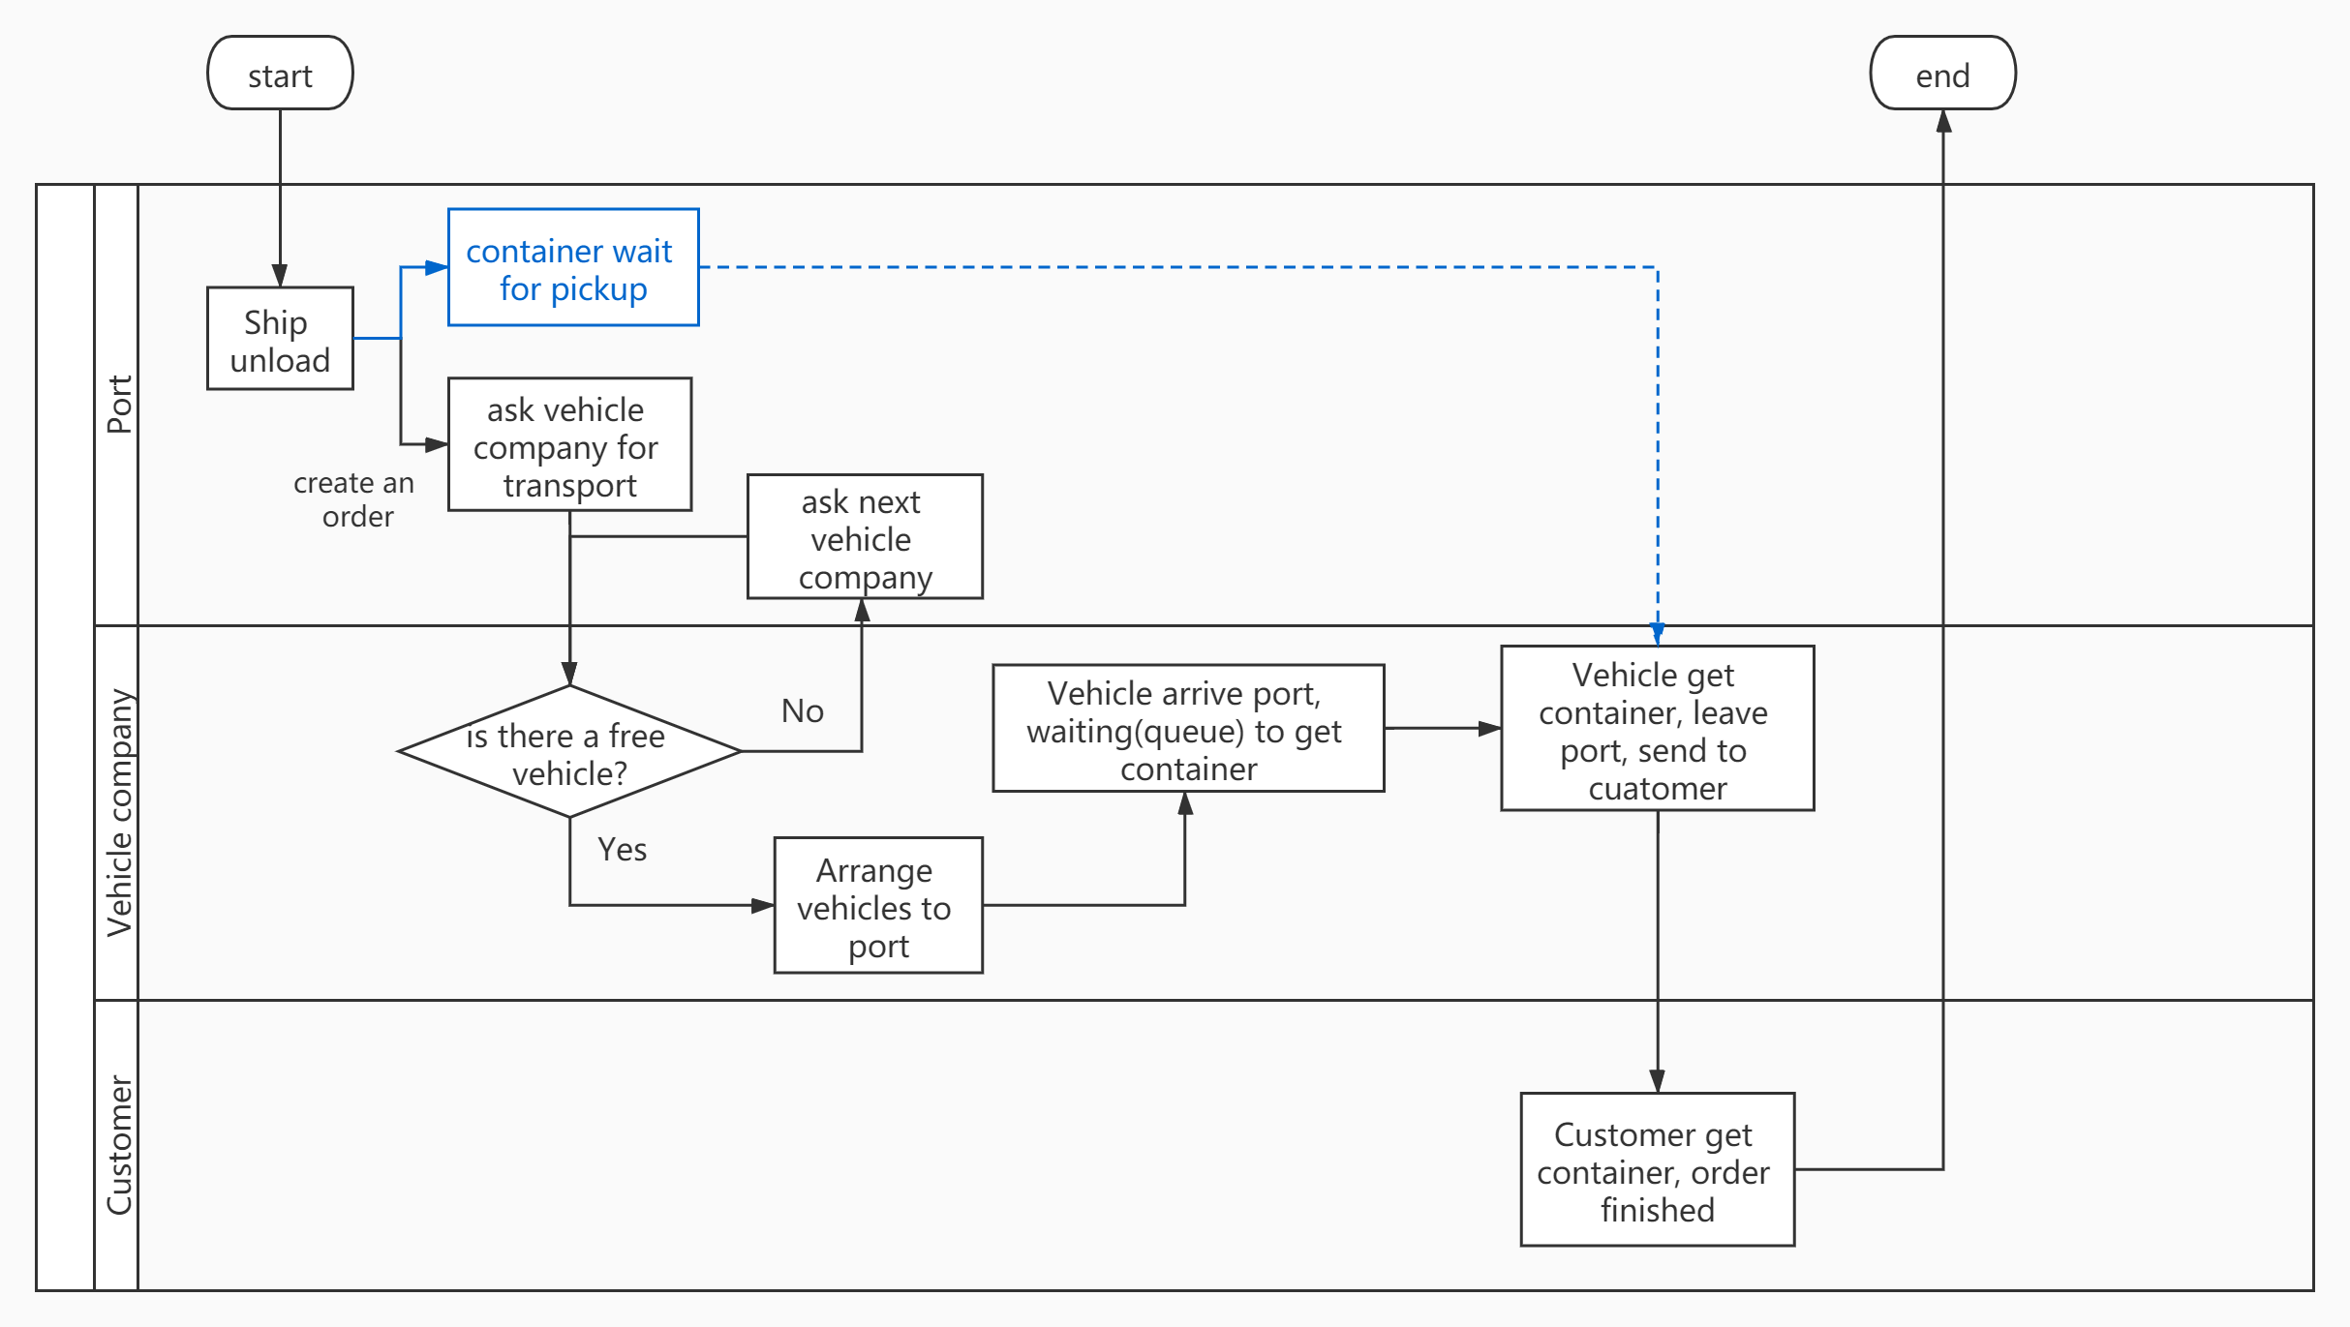
Methods
Simulation
1. Traditional system
1.1 Bilateral communication
Notes:
Based on the previously identified functions and roles, we designed the system process
In traditional system, port manager will ask transport company one by one until the order was accepted.

Slide 19
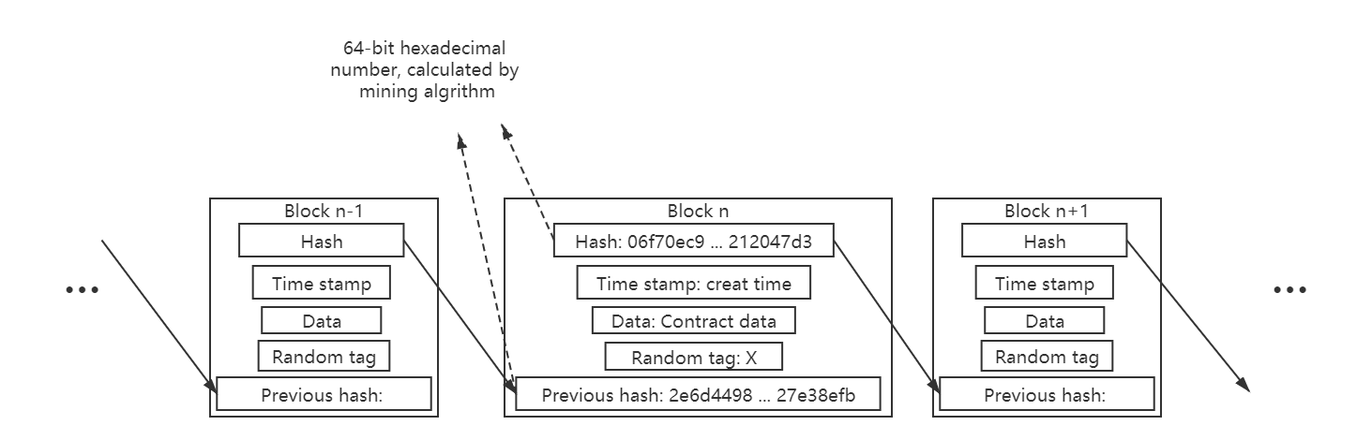
Methods
Simulation
2. Blockchain-based system
2.1 Block
- Hash
- Time stamp
- Data
- Random tag
- Previous Hash
2.2 Consensus mechanism
- proof of work(POW)
2.3 Reward mechanism
- Shipping commission
2.4 Anti-tampering mechanism
- one-way writing of historical records
Notes:
For a Blockchain-based system, we need to design four additional parts: block, consensus mechanism, reward mechanism and anti-tampering mechanism.

Slide 20
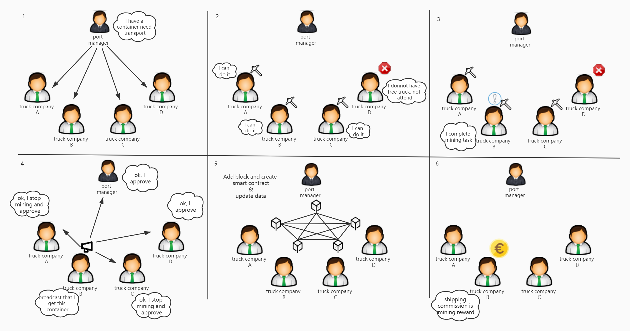
Methods
Simulation
2. Blockchain-based system
Notes:
We use the blockchain network to enable port management to send requests to multiple companies at the same time,
If the transportation company has free resources, it is allowed to participate in mining. The first company to complete the mining task obtains the shipping qualification of this container，then broadcasts the information to the network. only one company can get this order. And the commission will give as reward.

Slide 21
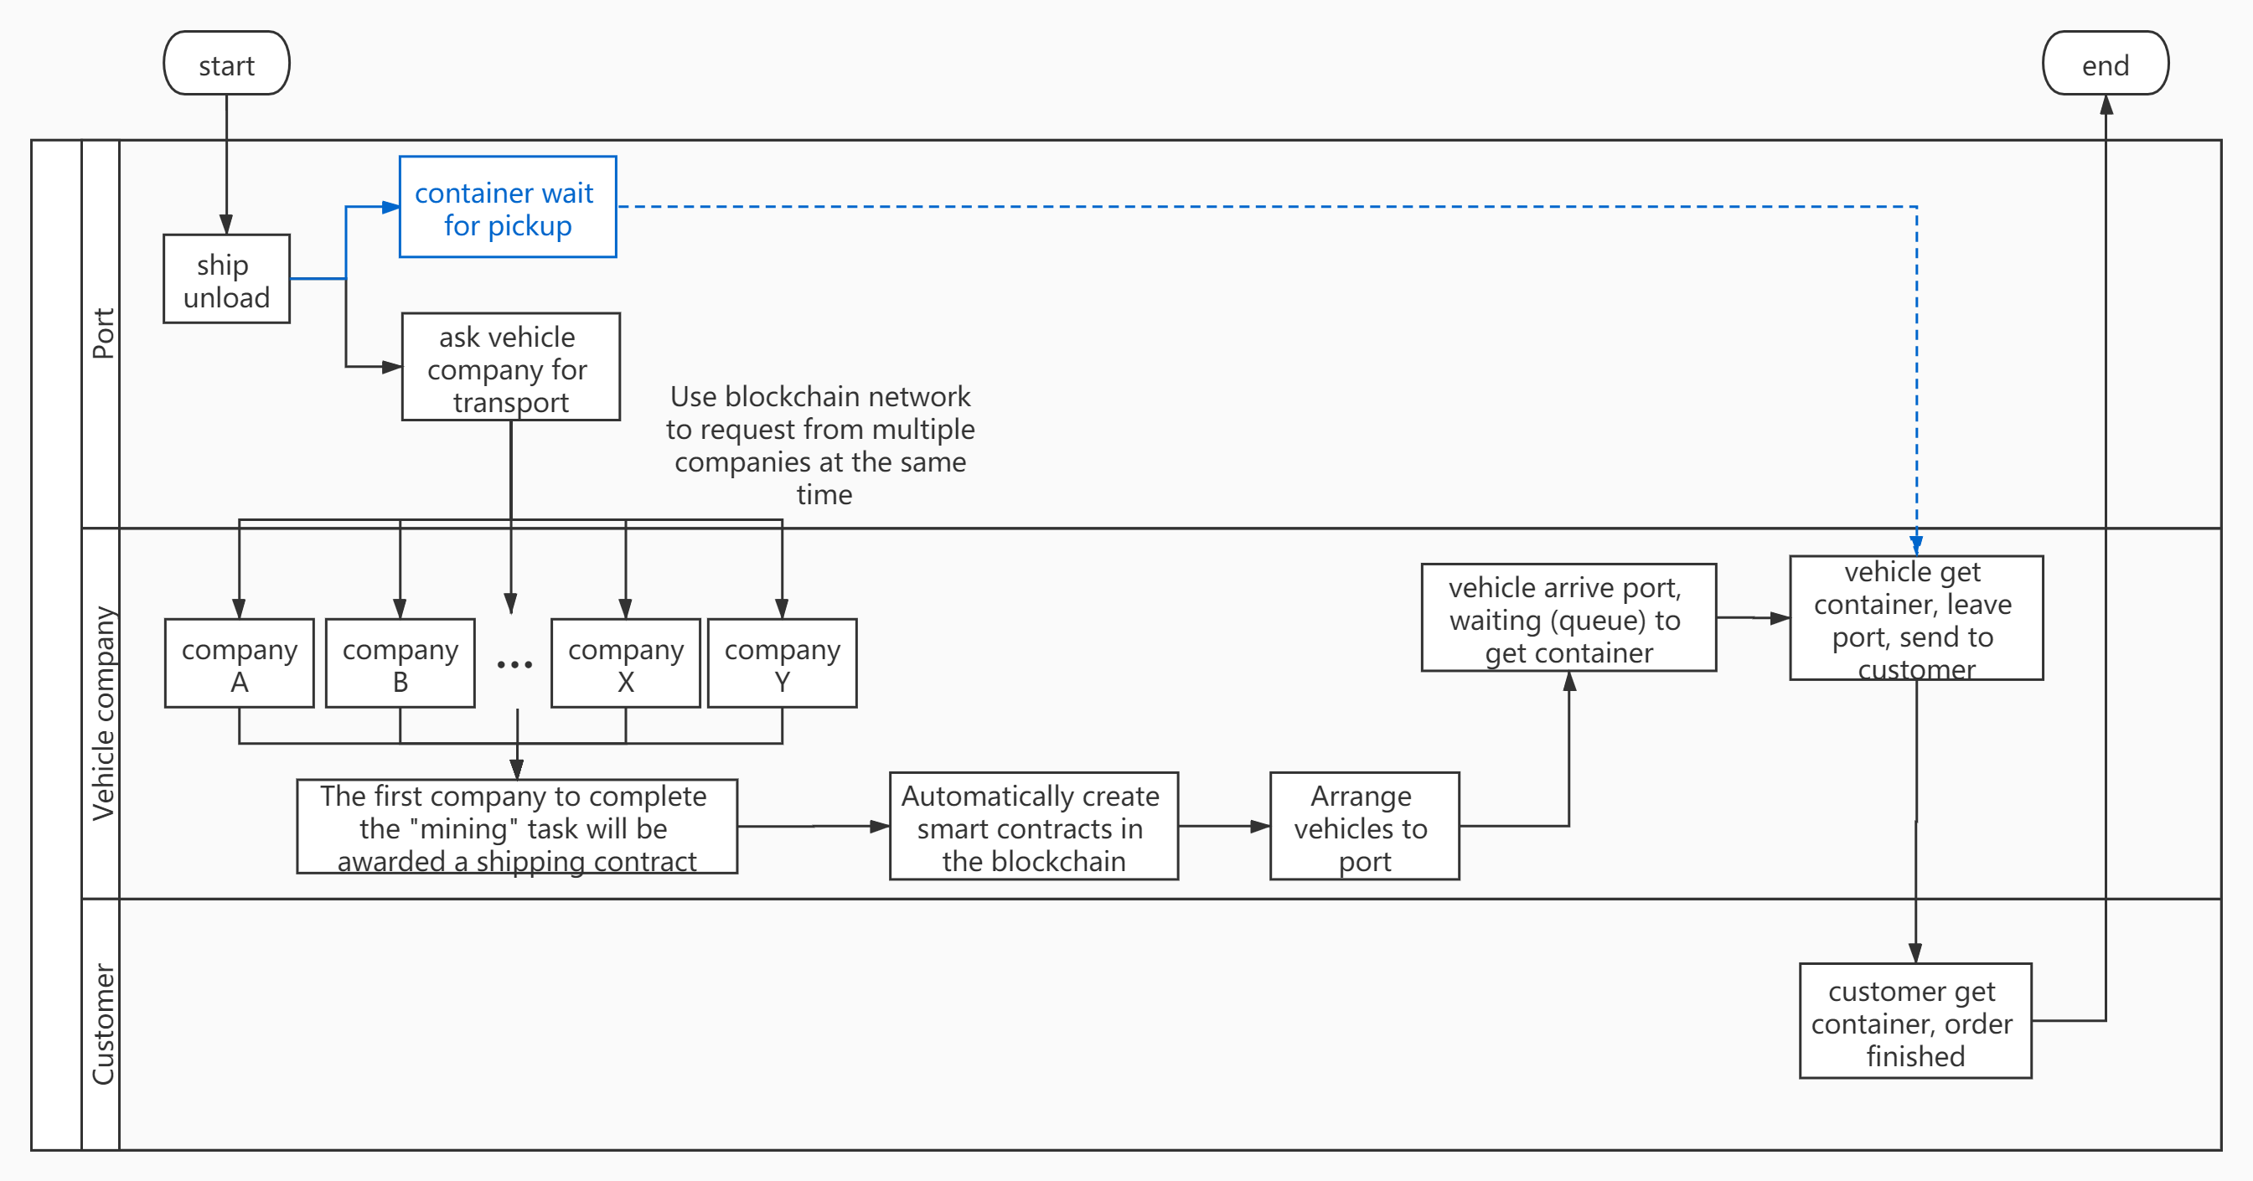
Methods
Simulation
2. Blockchain-based system
Notes:
Based on the design, we can have the flow chart.

Slide 22
Result & Analysis
Access speed to information
Overall time of cargo in port
Hinterland transportation modes’ capacity utilization
Port throughput
Notes:
After realize the simulation model, we collected the results of KPIs. Next, I will analyze the results in details.

Slide 23
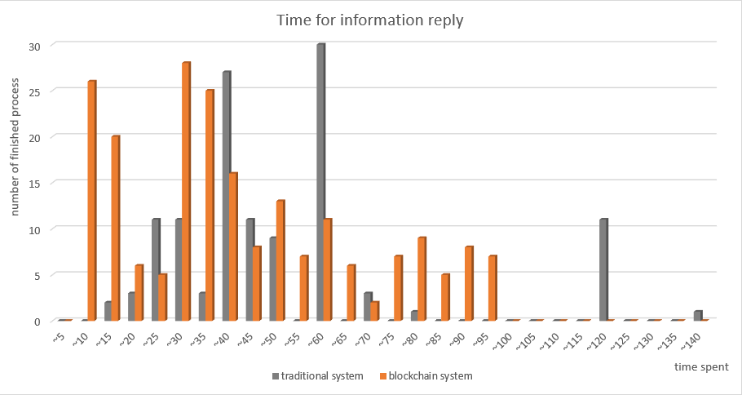
Result & Analysis
1. Access speed to information
This indicator shows the time required after the port initiate the request for transport resource, until the transportation company accepts and dispatches the vehicle to the port to pick up the cargo. This indicator can represent the speed of information reaction between the port and multiple transportation companies in the process.
- 5~35 response time:
The number of orders occupied by the Blockchain-based system is large, which means that compared to traditional system, the Blockchain-based system has an advantage in fast response.
- 100+ response time:
Only the traditional system still has orders processed, indicating that in the traditional system, there are orders that need spend a long time to complete.
*In this research, we count each request from the time it is created until the transportation company pick up the container. In this step, we run the simulation for 150 simulation time unit and collect the result.
Notes:
Access speed to information, this indicator shows the time required after the port initiate the request for transport resource, until the transportation company accepts and dispatches the vehicle to the port. This indicator can represent the speed of information reaction between the port and multiple transportation companies in the process.
From the collected results, we can see that in the response time of 5 to 35 unit time, the order completed by the blockchain-based system is much more than the traditional system. In this interval, we observed that the blockchain-based system has the ability to respond quickly.
for over 100 unit time, we observed that only traditional systems have orders completed.

Slide 24
Result & Analysis
1. Access speed to information
 | Traditional system | Blockchain system
COUNT | 123 | 209
MIN | 14.679 | 6.959
MAX | 135.214 | 94.784
AVG | 48.91214 | 39.66938
VAR | 709.6574 | 614.279
VAR(<100T) | 245.3815 | 614.279
Notes:
In 150 time-units, the traditional model processed a total of 123 orders and the blockchain-based system processed 209 orders. By analysis the data, we find the results are very interesting.
From average time spent, blockchain-based systems are slightly faster than traditional systems,
From the perspective of variance, the blockchain system is also slightly more stable than the traditional system.
However, if we only calculate the variance in less than 100 unit time, we find that the variance using traditional models is much lower than blockchain-based system. Which means if the long-delayed container is not considered, the order processing time of the traditional model is more average than blockchain system.

Slide 25
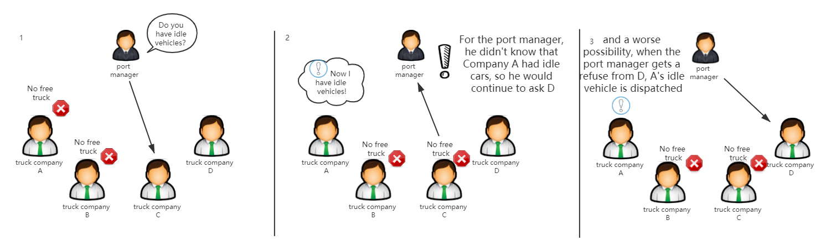
Result & Analysis
1. Access speed to information
Blockchain-based system processed more orders in same time
In terms of fast response, the Blockchain-based system performs better
If we don't consider the orders that are processed for a very long time, the order processing speed of the traditional system is more stable.
For the orders need very long time processed in the traditional model, they stack in repeat request for many times.
Notes:
In terms of information processing, we found:
In 150 simulation time, Blockchain-based system processed more orders.
In terms of fast response, the Blockchain-based system performs better
If we don't consider the orders that are processed for a very long time, the order processing speed of the traditional system is more stable. Which means in traditional system it is easier to predict the time of order processing.
For orders that took a long time to complete in traditional systems, we found that they in special case. During the Bilateral communication process, the port needs to ask the transport company one by one. Suppose that when port asking company C(Charlie) for resource, Company A(Alpha) has idle truck. But port manager does not know that, so he will continue ask company D(Delta). And a worse possibility, when the port manager gets a refuse from company D(Delta), idle truck of company A(Alpha) has dispatched, which makes waiting time even longer.

Slide 26
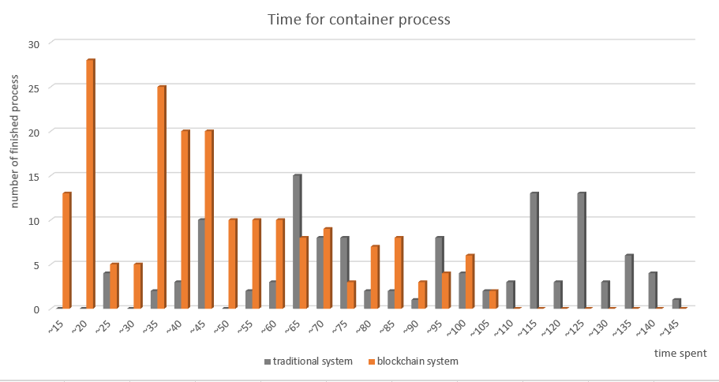
Result & Analysis
2. Overall time of cargo in port
This indicator represents the length of time the cargo stays in the port. For the port, the longer the cargo stays, the higher the extra cost. For customers, it will also take longer to receive the goods. Therefore, in port logistics, reducing the waiting time of containers at the port can not only bring economic benefits, but also better arrange the allocation of resources.
- Blockchain-based system:
· In 150 time units, ships a total of 197 containers
out of the port.
· 76 containers (38.5%) move out in 35 time units.
· Most container can move out of port in 105 time
units.
· Average process time 44.9
- Traditional system:
· In 150 time units, ships a total of 121 containers
out of the port.
· 6 containers (5.0%) move out in 35 time units.
· 46 containers(38.0%) move out more than 105
time units.
· Average process time 85.8
*In this research, we timed each container from the arrival of the port to the time when it stopped leaving the port. In this step, we run the simulation for 150 simulation time unit and collect the result.
Notes:
Overall time of cargo in port
We can found in 150 simulation time units, blockchain based system process 197 containers and traditional system only process 121. And In terms of time distribution and mean, the Blockchain-based system can make containers move out of the port faster.

Slide 27
Result & Analysis
2. Overall time of cargo in port
The waiting time for containers has been significantly reduced by using Blockchain-based system.
In terms of fast processing, the Blockchain-based system has better performance.
Notes:
Therefore, using the blockchain system can shorten the waiting time of containers at the port. Moreover, the use of blockchain systems also has a good performance in terms of fast transportation. If urgent orders need to be quickly delivered to customers, the blockchain system can provide better services.

Slide 28
Result & Analysis
3. Hinterland transportation modes’ capacity utilization
In the communication process between the port and the transportation company, the vehicle usage rate of the transportation company can represent whether the port has the ability to know the transportation resources statement. If the utilization rate is high in comparison, it means that the port can communicate with the transportation company in time and obtain updated information. For the port, if the communication efficiency is low, port cannot know in time which company has idle resource. This will result in the port not being able to make immediate arrangements, which may hold containers in port for long time. For the transportation company, if the port fails to request transportation resources in time, resulting in a low vehicle utilization rate, it will reduce the economic efficiency of the transportation company. For the transportation company, when the port still needs transportation resources, but the car utilization rate is still not good, it means that the port and the transportation company have low communication capacity and low communication efficiency, which will also reduce the economic efficiency of the transportation company.
Notes:
In the communication process between the port and the transportation company, the vehicle utilization rate can represent whether the port has the ability to know the transportation resources statement. If the utilization rate is high, it means that the port can communicate with the transportation company in time and obtain updated information.
In this part, we will compare the Company vehicle Utilization Rate and Overall Vehicle Utilization Rate for analysis.

Slide 29
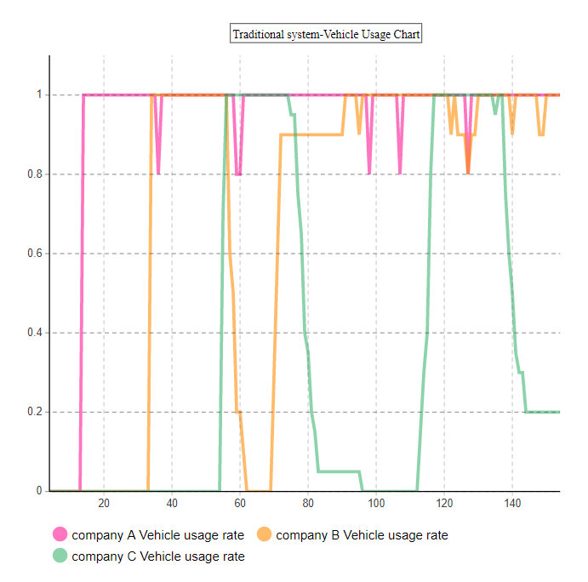
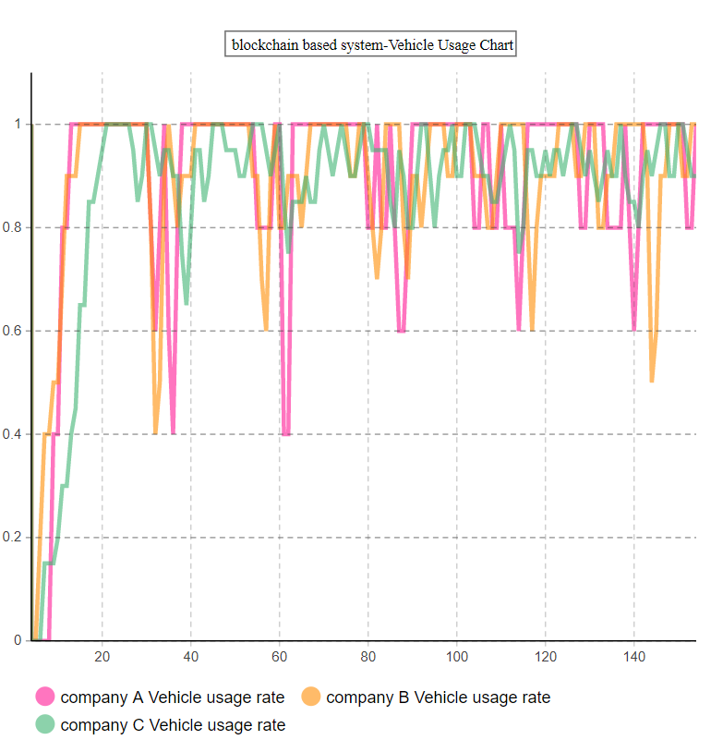
Result & Analysis
3. Hinterland transportation modes’ capacity utilization
3.1 Company vehicle Utilization Rate
Notes:
This is the line chart of vehicle Utilization Rate over time for each company in 150-time units.

Slide 30
Result & Analysis
3. Hinterland transportation modes’ capacity utilization
3.1 Company vehicle Utilization Rate
Traditional system
Large fluctuation amplitude
There are many cases where the vehicle Utilization Rate is 0
Blockchain-based system
High fluctuation frequency
Small fluctuation amplitude
Vehicle Utilization Rate is always at a high level
Notes:
By comparing vehicle utilization for each company in the two systems, although the rate fluctuates frequently in Blockchain-based system, the amplitude of the fluctuation is not large. Compared with the traditional system, Blockchain-based system can always maintain a higher and more average vehicle utilization rate.

Slide 31
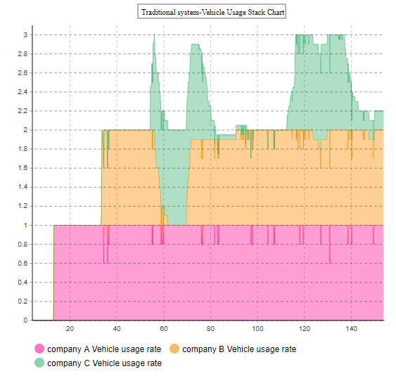
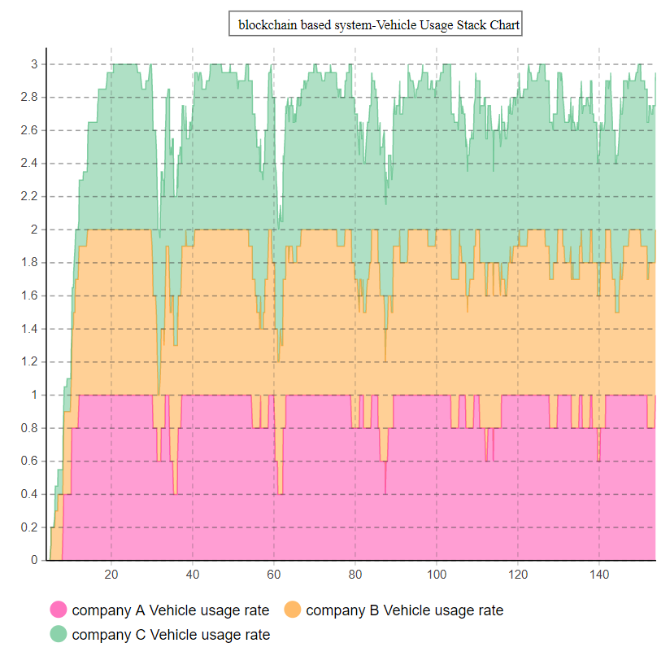
Result & Analysis
3. Hinterland transportation modes’ capacity utilization
3.2 Overall Vehicle Utilization Rate
Notes:
Here is the Stacked chart for Overall Vehicle Utilization Rate.

Slide 32
Result & Analysis
3. Hinterland transportation modes’ capacity utilization
3.2 Overall Vehicle Utilization Rate
Traditional system
In the early stages, B and C are idle for a long time
The overall utilization rate is not high, average* 66.1%
After 60 time units, average 78.6%
Blockchain-based system
In the early stages, overall usage rate has risen rapidly
The overall utilization rate is better, average* 88.8%
After 60 time units, average 91.0%
* The calculation of the average value is biased. Because the data refresh frequency in the chart is 0.001 unit time, the average cannot be calculated due to the large amount of data. Therefore, the overall rate for calculate the average is collected every 1 unit time.
Notes:
By comparing Overall Utilization Rate in the two systems, at the early stage, companies B(Bravo) & C(Charlie) are idle in the traditional system, while in Blockchain-based system the utilization rate of all three companies are rising quickly, and it can put more resources into use in a short time. For traditional system, the overall rate is not high, which indicates that by using Blockchain-based systems, cooperation between ports and transport companies is more efficient.

Slide 33
Result & Analysis
3. Hinterland transportation modes’ capacity utilization
In the traditional system, the port cannot know the company's vehicle usage status in time, which causes the utilization rate fluctuation amplitude large.
In the blockchain-based system, the vehicle resources of all partner companies are arranged centrally, which can reduce repeated waiting time.
The blockchain system can call a lot of resources in a short time, and basically maintains a high utilization rate in the process.
Traditional systems have a long waiting time for responses, and the blockchain system uses task publishing model to reduce the waiting time for responses.
Notes:
By observing these four graphs, we find that in terms of vehicle utilization, when using the traditional system, the rate fluctuates greatly for company C(Charlie). Although there are still many containers needs to be shipped at the port, the rate still be low for a long time.
In blockchain-based system, the vehicles of all companies are arranged centrally, which can reduce repeated waiting times. And it can quickly call resources in a short time and keep the utilization rate at a high level.
With the consensus mechanism, the blockchain system can replace the manual confirmation process with algorithm, which can reduce the waiting time for a response.
We can also see from the stacking diagram that the performance of the blockchain-based system is better than traditional system

Slide 34
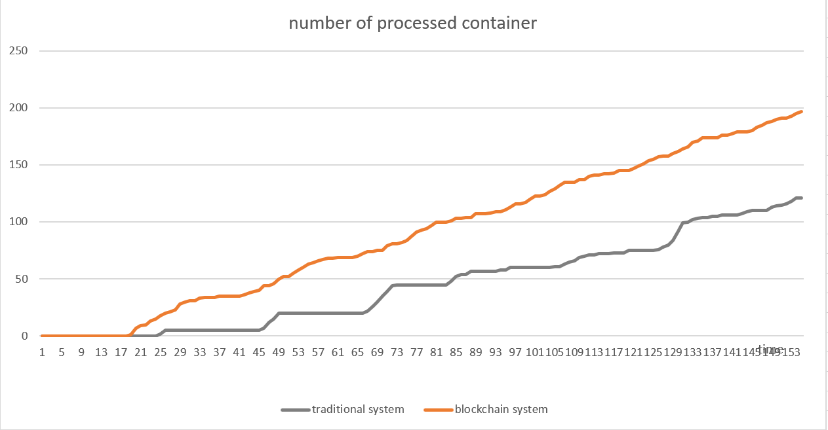
Result & Analysis
4. Port throughput
Port throughput represents the number of containers handled by a port within a certain period of time. For the port, being able to handle more containers in a short time can not only improve the efficiency of the port but also bring better economic benefits. In this KPI, we compare the efficiency of the two systems by comparing the number of containers handled by the port in a certain period of time.
*In this research, we run the simulation for 150 simulation time unit and collect number of processed container each 1 simulation time.
Notes:
For all ports, throughput is a very important indicator. Being able to handle more containers in a certain period of time can not only improve port efficiency, bring better economic benefits, but also have more time for allocate and adjust resource usage.

Slide 35
Result & Analysis
4. Port throughput
Trendline slope: Traditional 0.835
Blockchain 1.363
In Blockchain-based system, the growth rate is higher
In traditional system, there are cases where the container has not been processed for a period of time
Compared to the first container that left the port, the blockchain system is slightly earlier than the traditional system.
Notes:
In this indicator, we find that the processing speed of the blockchain system is greater than traditional system, and in traditional system, there are many times where no container is sent out of the port. In terms of processing speed and overall throughput, blockchain systems perform better than traditional systems
Summary:
Through the analysis of the collected data, we found that compared with traditional systems, using a blockchain-based system can increase the vehicle utilization rate of partner companies, reduce the waiting time of containers at a port, and increase port throughput to a certain extent. In the speed of information access, although there is no major improvement, but blockchain-based system can avoid the situation that the order has not been processed for a long time.

Slide 36
Result & Analysis
Problems
Blockchain requires the use of a large number of computing resources and storage units, which may be an additional cost for both transportation company and port.
The Blockchain system mainly replaces the manual confirmation step through the consensus mechanism, and then arranges the vehicles. So the choice of consensus mechanism is particularly important. In this system, we chose the POW method, but this method is not optimal in this system.
In the design of this system, a block will be created when an order created, which requires a lot of storage resources. Over time, this data chain will be very large. As a result, the speed of information traceability and inquiry becomes slow.
Since the Blockchain system is a distributed information system, in general, the more user nodes, the higher the built-in trust and security. However, in the case of cooperation between multiple companies, any situation that needs to reduce the benefits may cause users to exit the network, such as additional computing resource maintenance costs.
Although the use of the Blockchain system does not need to completely replace the PCS used by the transportation company or the port itself, it still needs to connect to a database and obtain certain information in real time.
Notes:
But during the simulation, we also found some problems using the blockchain-based system:
a.
Blockchain requires a large number of computing resources and storage units, which may be an additional cost for both transportation company and port.
b.
The Blockchain system mainly replaces the manual confirmation step through the consensus mechanism, and then arranges the vehicles. So the choice of consensus mechanism is particularly important. In this system, we chose the proof of work method, and set low workload level. If the workload increases beyond the average time of manual confirmation, the performance of the blockchain system will become very poor. So it is unclear how to choose a consensus mechanism and its impact on different consensus mechanisms.
c.
In the design of this system, one block will be created when an order created, which requires a lot of storage resources. Over time, this data chain will be very large. As a result, the speed of information traceability and inquiry becomes slow. In this regard, although it is possible to try to add a phased storage root node to relieve the storage pressure, this may increase the risk of information lost.
d.
Since the Blockchain system is a distributed information system, in general, the more user nodes, the higher the built-in trust and security. However, in the case of cooperation between multiple companies, any situation that needs to reduce the benefits may cause users to exit the network, such as additional computing resource maintenance costs or reduce revenue. So if we want to promote the Blockchain system in small port, we need to improve the communication efficiency while at least ensuring that the interests of any party are not harmed.
e.
Although the use of the Blockchain system does not need to completely replace the PCS used by the transportation company or the port itself, it still needs to connect to a database and obtain certain information in real time. This is also a place where users who have not used such systems need trust.

Slide 37
Conclusion
Overall, there are advantages to using Blockchain technology between ports and transportation companies. In the small port logistics system, the information of the port and the transportation company is not shared, so it is very difficult for the port to allocate resources. By using the Blockchain based system, transportation resources can be allocated in a timely manner under the condition of high information security. Under the premise of using an excellent consensus mechanism, such a system can reduce the waiting time to a certain extent, improve the overall vehicle resource utilization rate, and achieve the purpose of improving port efficiency. The Blockchain based system can communicate with the port in real time without the complete sharing of information. The built-in trust of the Blockchain can allow the cooperation between the port and the transportation company to be supervised by all nodes, which can provide a trust basis for the information exchange between the two parties to a certain extent.
But in general, there is great potential for using Blockchain technology in PCS of small ports.
Notes:
Overall, there are advantages to using Blockchain technology between ports and transportation companies. In the small port logistics system, the information of the port and the transportation company is not shared, so it is very difficult for the port to allocate resources. By using the Blockchain based system, transportation resources can be allocated in a timely manner under the condition of high information security. Under the premise of using an excellent consensus mechanism, such a system can reduce the waiting time, improve the overall vehicle utilization rate, and achieve the purpose of improving port efficiency. The Blockchain based system can communicate with the port in real time without the complete sharing of information,
**if have time**
(For example, when an order is initially created, the port only needs to publish the time information and the type of vehicle required, and after the order is accepted by the transport company, detailed information such as the location of the container could be sent to the corresponding transport company. And also it can write detailed information into smart contracts and publish them to the Blockchain network, allowing this process to be monitored. )
The built-in trust of the Blockchain can allow the cooperation between the port and the transportation company to be supervised by all nodes, which can provide a trust basis for the information exchange between the two parties to a certain extent.
Although there are still many challenges in using blockchain technology in small ports, but in general, there is great potential in using it.

Slide 38
Future Work
Impact of blockchain on information exchange between other roles.
Impact of different consensus mechanism
In addition to considering the communication between roles, there is also the value of in-depth research on how to use Blockchain technology in port logistics.
Traceability：guarantee transactions in financial terms
Real-time accessibility：track cargo
...
Notes:
Due to the characteristics of small ports, there is still have much things need to discuss.
In this research, we discussed the physical processes and information exchange between the port and the inland transportation company, but we still need to perform simulation experiments on how much other roles are affected by the blockchain.
And about the consensus mechanism, we choose proof of work in this research, However, its resource usage is too large, which makes me unable to achieve a larger model simulation, so we need to study how to choose a consensus mechanism in the future.
In addition, the blockchain itself also has value to do more research.

Slide 39
Reference
[1] C. W. Weimer, J. O. Miller, and R. R. Hill, “Agent-based modeling: An introduction and primer,” in 2016
Winter Simulation Conference (WSC), Washington, DC, USA, 2016, pp. 65–79, doi: 10.1109/WSC.2016.7822080.
[2] M. Francisconi, “An explorative study on Blockchain technology in application to port logistics,” 2017.
[3] L. Henesey and M. Anwar, “Development of State-of-the-Art on BlockChain technologies in Ports and Terminals:
activity 4.1.” 28-Aug-2019.
[4] J. Banks, Discrete-event System Simulation. Prentice Hall, 2001.
[5] A. Henesey, H. Sternberg, and L. Henesey, “Requirements Analysis of Information Integration of Small and Medium
Size Ports with Port Communities using Web Portals: A Swedish Port Perspective,” p. 16.
[6] “Digital Container Shipping Association Industry Blueprint Container Shipping 1.0,” p. 19, Sep. 2019.

Slide 40
Thank you!
Hangdong Chen
Jan. 27, 2020

